Slide 1

Human Skin Disease Detection Using AI
By : Dipti Pipaliya
(P2849179)

Slide 2
Human Skin Disease Detection Using AI
Content
Introduction
Problem Statement
Aim
Objective
Architecture
Related Work
Proposed System
Data Processing
Expected Out comes of Proposed System
Conclusion
References

Slide 3
Human Skin Disease Detection Using AI
1. Introduction:
The purpose of "Human Skin Disease Detection Using AI-Based Mobile Application" is to create a user-friendly and accessible tool that harnesses the power of artificial intelligence to accurately identify and diagnose a range of skin diseases through a mobile application.
By leveraging AI algorithms, this project aims to provide individuals with timely and reliable assessments of their skin health, facilitating early detection, prompt treatment, and improved management of various dermatological conditions.
Ultimately, the goal is to empower users to take proactive steps towards maintaining healthier skin and seeking appropriate medical care when needed.
As there many applications available in market for this but their accuracy rate is mostly near about 80% to 90 % so we are making more accurate application.

Slide 4
Human Skin Disease Detection Using AI
2. Problem Statement:
Skin diseases encompass a vast array of conditions, ranging from common dermatological concerns to rare and complex disorders, collectively posing a significant burden on global healthcare systems.
For these illnesses to be managed and treated effectively, prompt, and correct diagnosis is essential, yet it often presents a challenge due to the subjective nature of visual examination and the variability in clinical presentations.

Slide 5
Human Skin Disease Detection Using AI
3. Aim
Artificial Intelligence in Health Some other disadvantage to AI is that AI programs tend to educate vast quantities of information from a range of sources like pharmacy reports, telemedicine, extended warranty records etc.
As the data has been scattered with the prevalence of visiting patients with various health agencies or changing insurance firms, the knowledge becomes confusing and less easily understood therefore about which the risk of failure and the level of data gathering escalate.
Main motivation is to create that only one app can detect any disease and give suggestion of what type of medication they need or need to go to doctor.

Slide 6
Human Skin Disease Detection Using AI
4. Motivation
Already Available Concept
This review explores the transformative potential of machine learning in dermatology, evaluating cutting-edge algorithms such as k-nearest neighbor, support vector machine, convolutional neural networks, recurrent neural networks, generative adversarial networks, and attention mechanisms for their ability to revolutionize the diagnosis and treatment of skin diseases, aiming to enhance healthcare delivery and patient outcomes through advanced computational techniques. [4],[5]
Motivation of Advancement
Advancements in machine learning for dermatology encompass a range of techniques beyond traditional algorithms like k-nearest neighbor and convolutional neural networks. These include transfer learning for leveraging pre-trained models, ensemble methods to improve accuracy, multi-modal learning integrating various data sources, explainable AI for transparency, active learning for efficient data annotation, data augmentation for diversity, real-time decision support systems, privacy-preserving techniques, longitudinal analysis for disease tracking, and integration with electronic health records. These innovations aim to enhance diagnostic precision, treatment effectiveness, and overall healthcare delivery in dermatology through advanced computational approaches.

Slide 7
Human Skin Disease Detection Using AI
5. Detailed Literature Review
SN | Reference | Topic | Methodology Used | Parameters | Remarks / Findings
1 | ResearchGate | Early melanoma diagnosis with mobile imaging | Quantitative | This technology aims to improve early detection rates by enabling users to conduct self-assessments and facilitating remote screenings in underserved areas, potentially enhancing patient outcomes through timely intervention. | Refining algorithms for early melanoma diagnosis via mobile imaging could involve enhancing convolutional neural networks (CNNs) to better detect subtle lesion features, exploring ensemble methods to improve classification accuracy, and incorporating techniques like transfer learning to leverage large, diverse datasets for training robust models specifically tailored for dermatological applications.
2 | ResearchGate | Bag-of-Features Classification Model for the Diagnose of Melanoma in Dermoscopy Images Using Color and Texture Descriptors | Qualitative | Research on the Bag-of-Features (BoF) classification model for melanoma diagnosis in dermoscopy images integrates color and texture descriptors to classify image patches. This approach aims to enhance diagnostic accuracy by capturing distinctive melanoma features through feature extraction and machine learning algorithms, potentially supporting dermatologists with automated analysis tools for more effective skin cancer detection. | Refining feature extraction methods by exploring more advanced techniques such as deep learning architectures like convolutional neural networks (CNNs) could improve the model's ability to capture complex patterns in skin lesions. Additionally, incorporating multi-modal features, including clinical data or genetic information, alongside color and texture descriptors may provide a more comprehensive diagnostic approach.
3 | Oral Oncology Reports | Innovative approaches for skin disease identification in machine learning: A comprehensive study | Mixed | The comprehensive study on innovative approaches for skin disease identification in machine learning examines the effectiveness of various algorithms including k-nearest neighbor, support vector machines, convolutional neural networks (CNNs), and advanced deep learning models like recurrent neural networks (RNNs) and generative adversarial networks (GANs) | Refining algorithms for skin disease identification in machine learning could involve enhancing convolutional neural networks (CNNs) with deeper architectures or incorporating attention mechanisms to focus on relevant image features. Additionally, optimizing support vector machines (SVMs) for better classification boundaries in high-dimensional feature spaces and exploring ensemble methods to combine predictions from multiple models could further improve diagnostic accuracy and robustness in dermatological image analysis.
4 | IEEE Access | Region-of-Interest Based Transfer Learning Assisted Framework for Skin Cancer Detection | Quantitative | The research on Region-of-Interest (ROI) Based Transfer Learning Assisted Framework for Skin Cancer Detection focuses on leveraging transfer learning techniques to enhance the accuracy of automated skin cancer detection. This approach involves identifying and extracting regions of interest within dermatological images that are most indicative of malignancy. By adapting pre-trained models on large datasets, the framework aims to improve the generalization and efficiency of skin cancer classification, potentially aiding dermatologists in early and accurate diagnosis through advanced computational methods. | refining transfer learning strategies by fine-tuning models on specific dermatological datasets could improve their ability to extract relevant features from skin lesion ROIs. Additionally, integrating multi-modal data such as patient history, genetic information, or clinical notes alongside image ROIs could provide a more comprehensive context for diagnosis. Exploring advanced deep learning architectures like attention mechanisms or capsule networks tailored for ROI analysis may further enhance the framework's capability to discern subtle patterns indicative of skin cancer.
Proposed Work |  | The proposed enhanced framework seeks to improve current methods by integrating advanced deep learning architectures such as attention mechanisms and capsule networks, specifically tailored for precise analysis of regions of interest in skin lesions & also introducing a concept of skin deases detaction to market

Slide 8
Human Skin Disease Detection Using AI
5. Background
Application Name | Company Name | Description
SkinVision | SkinVision BV | Allows users to take photos of skin lesions and provides risk assessment for skin cancer.
First Derm | iDoc24 AB | Offers remote dermatology consultations and assessments for various skin conditions.
DermaSensor | DermaSensor Inc. | Provides AI-powered skin cancer screening using a handheld device and smartphone app.
VisualDx | Logical Images | Offers a comprehensive database of dermatological images and diagnostic support tools.
Miiskin | Miiskin Aps | Facilitates tracking and monitoring of moles and skin changes for early detection of skin cancer.
SkinVision | SkinVision BV | Empowers users to monitor changes in moles and skin lesions for early detection of melanoma.
DermEngine | MetaOptima Technology Inc. | Offers dermatology imaging and analytics software for skin cancer detection and management.
My SkinPal | My SkinPal Pty Ltd | Provides personalized skin analysis and risk assessment for various skin conditions.

Slide 9
Human Skin Disease Detection Using AI
5. Methodology
For developing a Human Skin Disease Detection using AI-Based Mobile Application, a quantitative approach will primarily be used to evaluate the performance metrics of the AI model, such as accuracy, sensitivity, and specificity, across diverse datasets. This approach is essential for objectively measuring the diagnostic capabilities and reliability of the application in clinical scenarios.
How to evaluate performance .
To evaluate the AI-based skin disease detection app, I'll gather a diverse set of skin disease images, train the model, and test its accuracy, sensitivity (recall), and specificity against real cases. Using techniques like cross-validation, I'll ensure the model's robustness. The results, including true positives and negatives, false positives and negatives, and ROC curves, will guide decisions on deploying the app effectively in clinical settings.

Slide 10
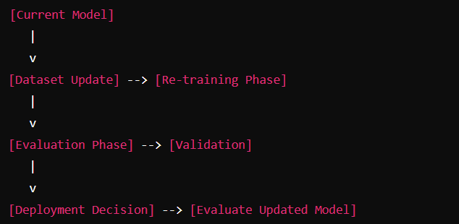
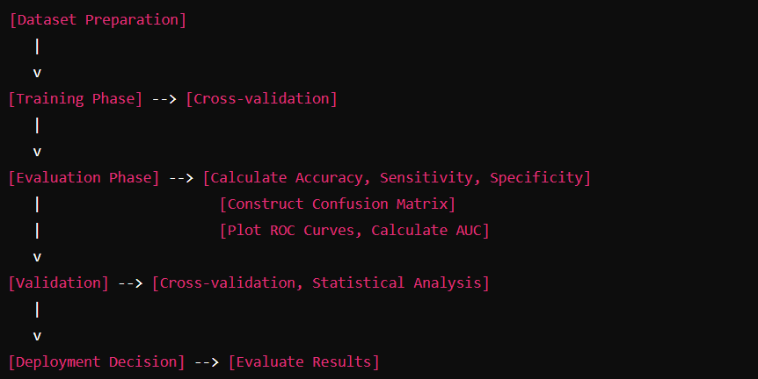
Human Skin Disease Detection Using AI
6. Proposed System & Data Processing
< ----------- K-fold Cross Validation Technique
< ----------- Using Confusion Matrix
< ----------- Based on accuracy, sensitivity, specificity
Used By available holders
Proposed Enhancement By Research

Slide 11
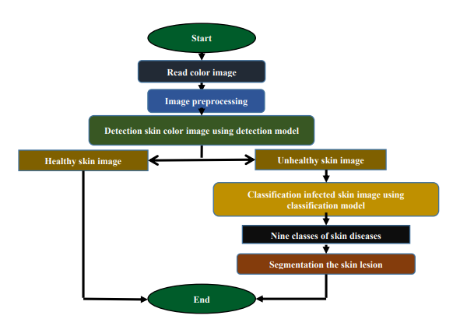
Human Skin Disease Detection Using AI
7. Expected Outcome
< - -- Python with OpenCV
< - -- CNN, SVM & Random Forest
< - -- Mentioned in next Slide
< - -- U-Net, Mask R-CNN

Slide 12
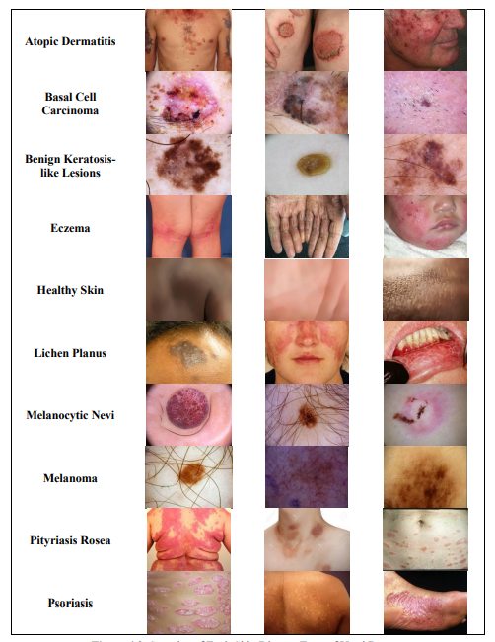
Human Skin Disease Detection Using AI
8. Types Of Skin Disease

Slide 13
Human Skin Disease Detection Using AI
8. Conclusion
Skin disorders pose a serious threat to healthcare due to their wide range of symptoms and effects on quality of life.
Focus on analyzing the effectiveness of three prominent algorithms: CNN, KNN, and LSVM, which have demonstrated good results in classifying various skin diseases.
Utilizing a variety of datasets from archives such as ISIC and ISBI, such as PH2, MED-NODE, DermIS, DermQuest, and others, the study thoroughly assesses these methods.
Evaluate each algorithm’s advantages and disadvantages in detail, paying special attention to CNNs.
Promising substitutes for conventional machine learning techniques are deep learning approaches, such as fully connected (CNNs) and feature extraction architectures.

Slide 14
Human Skin Disease Detection Using AI
9. References
Do TT, Zhou Y, Zheng H, Cheung NM, Koh D. Early melanoma diagnosis with mobile imaging. no. May 2015. 2014 36th annual international conference of the. IEEE Engineering in Medicine and Biology Society, EMBC; 2014. p. 6752–7. 2014.
Aleem M, Hameed N, Anjum A. m-Skin doctor: a mobile enabled system for early melanoma skin cancer detection using support vector machine, vol. 2; 2017. p. 468–75.
Barata C, Marques JS, Rozeira J. “The role of key point sampling on the classification of melanomas in dermoscopy images using bag-of-features,”. In: Iberian conference on pattern recognition and image analysis. vol. 7887. LNCS; 2013. p. 715–23.
Ashraf R, Afzal S, Rehman AU, Gul S, Baber J, Bakhtyar M, Mehmood I, Song OY, Maqsood M. Region-of-Interest based transfer learning assisted framework for skin cancer detection. IEEE Access 2020;8:147858–71.
Vayadande K. Automated multiclass skin disease diagnosis using deep learning. Int J Intell Syst Appl Eng Jan. 2024;12(11s):327–36.

